Slide 1
11/10/2024

Slide 2
I
PYTHON BASICS
Python for data science
WORKING WITH ARRAYS
Numpy
II
DATA SCIENCE 2 DATA & A.I. 3
IV
DATA VISUALISATION
Matplotlib
DATA ENGINEERING
pandas
III
V
MACHINE LEARNING
Automatically find patterns

Slide 3

MACHINE LEARNING
scikit-learn

Slide 4
01
WHAT IS MACHINE
LEARNING
Automatically find patterns
05
DECISION TREES
Best separating lines
INTRODUCING
SCIKIT-LEARN
Machine learning with Python
02
MACHINE LEARNING
06
K-MEANS CLUSTERING
Object grouping
HYPERPARAMETERS AND CROSS VALIDATION
Holdout samples and cross-validation
03
07
ASSOCIATION RULES
Frequent itemsets
REGRESSION
Best fitting line
04
08
ARTIFICIAL NEURAL
NETWORK
Imitate the human brain

Slide 5

HYPERPARAMETERS AND MODEL VALIDATION
Holdout samples and cross-validation

Slide 6

WHAT KIND OF PROBLEMS CAN YOU SOLVE WITH
MACHINE LEARNING
U N S U P E R V IS E D
S U P E R V IS E D
Value estimation / regression: predict a continuous variable
e.g. sales prediction; car use
Classification: predict a categorical variable
e.g. churn prediction; diagnosis
Segmentation / clustering: split or group cases/observations
e.g. customer segmentation; document topic search
Co-occurence / association rule discovery: events happening together
e.g. market basket analysis ; recommendation system
Notes:
Supervised geven we de oplossing, unsupervised gaat hij zelf patronen zoeken
Dan nog een verschil tussen met getallen of continue variabelen en met categories
Association rules is gewoon kansrekening, bijvoorbeeld als hij al een printer in zijn winkelmandje heeft wat is dan de kans dat hij ook een cartridge koopt
- Gaan wij niet zien

Slide 7
DATA ANALYTICS PIPELINE
DATA PREPARATION
Load (labeled) source data
Compile feature matrix
Compile target array (for supervised methods)
MODEL SELECTION AND HYPERPARAMETER SELECTION (MODEL SPECIFIC)
Decide on the method to use (linear regression, decision tree, K-means clustering, …)
Decide on the hyperparameter to use (degree of polynomial, tree depth, number of clusters, …) Hyperparameters are parameters that the algorithm uses to derive a model
Hyperparameters depend on the method (every methods has it’s on kind of hyperparameters)
DERIVE MODEL FROM LABELED DATA (TRAIN MODEL/FIT MODEL)
Apply the method/algorithm on the labeled data to derive the model
DISPLAY MODEL (MODEL SPECIFIC)
Display the resulting model
The resulting model depends on the method used (equation of regression line with intercept and slope, decision tree with nodes and split
conditions, groups of observations with centroid, …)

Slide 8
DATA ANALYTICS PIPELINE
VALIDATE MODEL USING LABELED DATA (SUPERVISED LEARNING)
Predict target feature for the labeled data
Calculate the difference between predicted and real values for the labeled data / calculate confusion matrix (classification)
Calculate validation metrics for the labeled data
Regression : MAE, MAPE, RMSE, …
Classification : accuracy, precision, recall, f-score, AUC, ROC
APPLY MODEL ON NEW DATA
Apply the model on new data
In case of supervised machine learning methods, this will predict the target feature for new data
In case of unsupervised machine learning methods, this will restructure the feature data (clusters, association rules, new feature matrix with reduced dimensions)

Slide 9


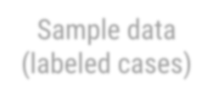

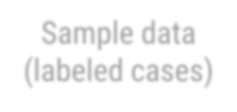


TRAIN - TEST SPLIT
Take part of the data to train model
Sample data (labeled cases)
Sample data (labeled cases)
Take another part of the data to test model
Sample data (labeled cases)
Notes:
Vanaf je een model hebt dat getrained is gaan we het testen altijd met een aparte dataset.

Slide 10
CROSS-VALIDATION
ALTERNATIVE FOR SPLITTING LABELED DATA INTO TRAINING SET AND TEST SET
The problem with splitting labeled example data into a training set and test set is that less labeled examples are available for training (as they are set aside for validation). In general, the more labeled examples for training, the better the model. But labeling a dataset can be very costly, hence to ‘loose’ valuable labelled examples to testing might not be preferable, especially for smaller labeled dataset.
The solution might be cross validation.
CROSS-VALIDATION
Cross-validation validation means that the labeled examples are split into multiple partitions and that multiple models are trained on different partitions. Every time, one partition of the labelled data is hold out for testing, and all other partitions are used for training (and the hold out partition changes every time). So, for N partitions, N different models are trained, with one of the N partitions as hold out sample for testing, and the N-1 other partitions for training. As a result, we have N models, all trained on slightly different data, covering all the examples in the labeled dataset (all examples are used N-1 times for training, and once for testing), resulting in N validation metrics. Those validation metrics can be combined, e.g. by calculating the mean over the N validation metric values.
The advantage of this method is that all data is used both for training and testing, and that the combined validation metrics over all parts of
the data give a better measure for global performance.
The disadvantage is that we end up with multiple models. That means there is no single model to use for predicting new data. One can select the best model, but that choice might be biassed, because the difference in performance is due to difference in training and validation data, so is based on coincidence. There is no guarantee that that model will also perform best on new data (we come back to that later).
Cross-validation is commonly used in model selection and hyperparameter tuning (see later).
Notes:
Cross validation is vrij simpel, we gaan onze dataset opsplitsen in verschillende stukken of vaults

Slide 11
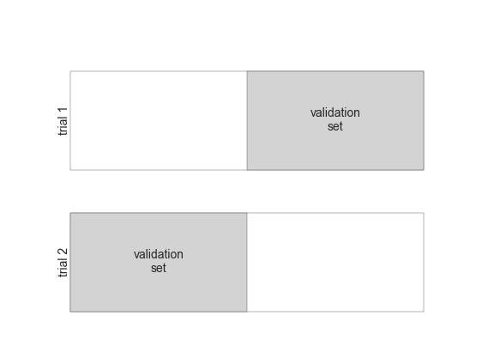
CROSS-VALIDATION
(2-FOLD CROSS VALIDATION)
Notes:
Hier verdeeld in 2 stukken

Slide 12

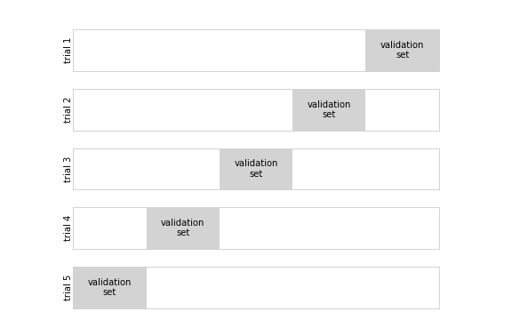
CROSS-VALIDATION
(K-FOLD CROSS VALIDATION)
Notes:
Kan ook in meerdere stukken, dan gaan we een stuk gebruiken om de test te doen en al de andere om te trainen. Dat gaan we n-aantal keer doen gelijk aan n-hoeveelheid stukken. We krijgen dan n-aantal modellen die we met elkaar kunnen vergelijken
Zou normaal allemaal ongeveer dezelfde score hebben en dan kunnen we de beste van de n-modellen kiezen om een predictie te doen

Slide 13
CROSS VALIDATION WITH SCIKIT-LEARN
from sklearn.model_selection import cross_val_score
scores = cross_val_score(model, X, y, cv=5)
Parameters
model : e.g. LinearRegression, DecisionTreeClassifier, …
X : feature matrix y : target vector cv :
int: number of cross validation folds (default = 5-fold)
splitter: e.g. LeaveOneOut() (from sklearn.model_selection import LeaveOneOut)
Returns
scores : array with scores (these are model dependent, e.g. accuracy for decision trees and accuracy for linear regression)
Notes:
Hier kunnen we dan deze functie voor gebruiken. We geven die whatever model we hebben, de inputs, outputs en de cross-validation fault, deze bepaalt in hoeveel stukken we deze zullen kappen. Ook het aantal keer dat hij zal trainen
Dan krijgen we hier een array van n-lang gelijk aan de cv. In dit geval 5

Slide 14
SIMPLE MODELS VERSUS COMPLEX MODELS UNDERFITTING VERSUS OVERFITTING
MULTIPLE MODELING TECHNIQUES
When using supervised machine learning, multiple techniques can be used to derive a predictive model
regression: linear regression, polynomial regression, artificial neural network, …;
classification: decision tree, support vector machine, artificial neural network, ….
The challenge is to select the technique that is most appropriate for your problem or data. That does not necessarily mean the most advanced or complex method. The best choice has to do with underfitting and overfitting.
SIMPLE METHODS
A simple method is a method that uses a limited set of parameters to create a predictive model. The limited number of parameters reduces the flexibility to capture patterns in data.
The problem with simple models is UNDERFITTING, i.e. the model is not flexible enough to capture the patterns in the data.
A good example of a simple method is linear regression, which simply tries to fit a straight line through the data, and hence only uses an intercept parameter and one slope parameter for every dimension (every independent feature or predictor). That works very well if the data has more or less the shape of a cloud around a linear line. But that will not work if the data does not have a linear shape (e.g. U-shaped data). The only thing linear regression can do is to fit a straight line, nothing more, nothing less.

Slide 15
SIMPLE MODELS VERSUS COMPLEX MODELS UNDERFITTING VERSUS OVERFITTING
COMLEX METHODS
A complex method is a method that uses an extended set of parameters to create a predictive model. The extended number of parameters increases the flexibility to capture patterns in data.
The problem with complex models is OVERFITTING, i.e. the model is too flexible and does not grasp the general pattern but just grasps the characteristics of individual cases.
A good example of a complex method is high order polynomial regression, which tries to fit a high order polynomial through the data, and hence requires much more parameters besides intercept and slope (c₁ x¹, c₂ x², c₃ x³, … c_{n} x^{n}). That works very well if the data has more or less the shape of the polynomial, but can go wrong if the data has a different shape, because the polynomial will start predicting individual cases instead of the general pattern.
HOW TO DETECT UNDERFITTING AND OVERFITTING
Underfitting : the model will score bad on both training set and test set (the model is not able to capture any relevant pattern)
Overfitting : the model will score good on the training set but bad on the test set (the model got tailored to the examples in the training set, but is not able to generalize, not able to predict new data well)

Slide 16
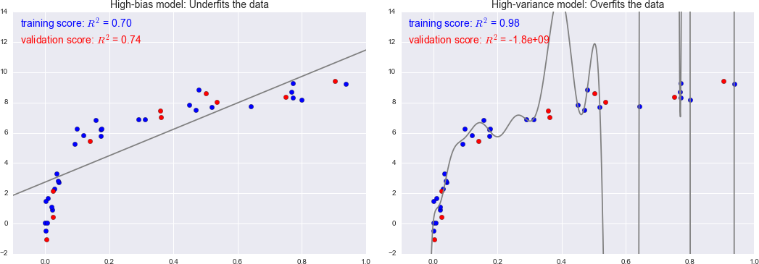
SIMPLE MODELS VERSUS COMPLEX MODELS UNDERFITTING VERSUS OVERFITTING
Notes:
Overfitting en underfitting enorm belangrijk in machine-learning
Hier zien we polynomiale regressie, waar we iets zullen voorspellen, elke top en minimum wijst op een extra graad in de functie – hoe complexer ons model wordt en hoe meer mogelijkheden hij krijgt
Hier links zien we gewoon lineaire regressie, heeft 2 parameters – hier is sprake van underfitting – te weinig parameters – model is te simpel
Rechts zien we een polynomiale regressie met enorm veel bochten, wilt zeggen dat er veel kwadraten zijn. Hier is sprake van overfitting – te veel parameters – model is te complex
Te herkennen bij enorm hoge score op trainingdataset en slechte score op test dataset
De blauwe punten hier zijn gebruikt om te trainen de rode om te testen
Lossen we op door minder parameters te geven, dan zal de training score een beetje naar beneden gaan en de test omhoog

Slide 17
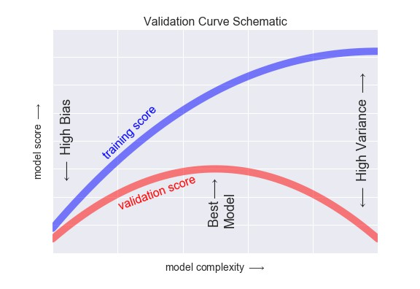
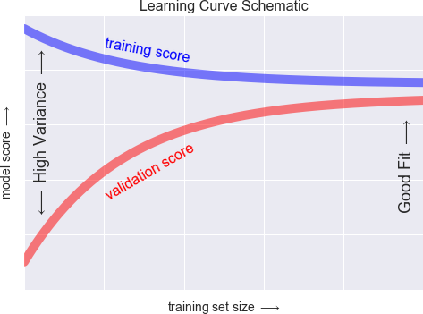
SIMPLE MODELS VERSUS COMPLEX MODELS UNDERFITTING VERSUS OVERFITTING
Notes:
Ipv simpeler model kunnen we ook meer trainingsdata geven, kunnen we doen door de data die we hebben een beetje aan te passen (helderder of donkerder maken), stel we hebben foto’s kunnen we de kleur dan een beetje te veranderen of in te zoemen of de foto te draaien

Slide 18
MODEL SELECTION AND HYPERPARAMETER TUNING TRAIN – VALIDATE - TEST SPLIT
MODEL SELECTION AND HYPERPARAMETER TUNING
The challenge is to select the modeling technique that is most appropriate for your problem or data. This is called model selection (e.g. decision tree, support vector machine, artificial neural network).
But every method also has hyperparameters that also influence the model and hence can have a big impact on the model quality:
Decision trees : tree depth, minimum samples split, maximum leaf nodes, . .
Support vector machine : kernel function, C, gamma, …
Artificial neural network : number of layers, number of neurons per layer, activation function, …
So it is not only about choosing the right modeling technique, but also the right hyperparameters. This is called hyperparameter tuning.
Mostly, it is only possible to find the best modeling technique and set of hyperparameters by trial and error. But doing this right requires a train-validate-test setup (see below), meaning that more labeled examples are lost for training.
TRAIN – VALIDATE - TEST SPLIT
Instead of a train-test split, model selection and hyperparameter tuning requires 3 subsets of labeled examples :
Train dataset : dataset used to train multiple models with multiple hyperparameter sets. The result is a set of models with a set of hyperparameters, all trained on the same training set.
Validation dataset : dataset to validate all models and hyperparameter sets generated in the previous step. All models and hyperparameter sets are validated using the same validation set. Select the best scoring model and hyperparameter set.
Test dataset : dataset for the ultimate, independent test of the one selected best model and hyperparameter set from the previous step to check whether the selected model is general enough to predict new data.
Notes:
We hebben een stuk om te trainen een een stuk om te valideren nu kunnen we ook nog een derde stuk nemen om te testen. Is een volledig onafhankelijke dataset om alles nog eens te testen. We krijgen Train, Validate en Test
Dan hebben we nog minder data om mee te trainen maar dit is wat we bij neurale netwerken gaan doen. Dan hebben we altijd 3 stukken (Zal 80-10-10 of 90-5-5) zijn

Slide 19
MODEL SELECTION AND HYPERPARAMETER TUNING WITH CROSS-VALIDATION
USING CROSS-VALIDATION FOR MODEL SELECTION AND HYPERPARAMETER TUNING
Cross-validation comes in handy for model selection and hyperparameter tuning because it allows multiple training and testing runs on multiple
labeled subsets making use of all information in the labeled dataset and excluding the coincidence factor of data selection.
Using cross-validation for model selection and hyperparameter tuning only requires the labelled example dataset to be split into two labeled subsets instead of three labeled subsets (train-validate-test subsets)
PRACTICAL SETUP : TRAIN/VALIDATE – TEST SPLIT
Split the labeled data into two subsets: a train/validate subset and a holdout test subset
Use the train/validate subset to train multiple modeling techniques with multiple hyperparameter sets using cross-validation
Every modeling technique/hyperparameter set is trained and validated multiple times, each time validated by one partition and trained using all other partitions. For every modeling technique/hyperparameter set, the average of all validation scores over all runs is calculated
Select the modeling technique and hyperparameter set with the highest average score (average of all scores over all runs of the cross- validation) in the previous step
Train a new model using the best modeling technique and hyperparameter set as selected in the previous step. Use all data in the
train/validate labeled subset for the training
So the train/validate labeled subset is used twice, once to find the best modeling technique/hyperparameter set using cross-validation, once to train a new model based on the best modeling technique/hyperparameter set
Test the model trained in the previous step using the holdout test set for an independent test (test generalization on new data)
Notes:
We kunnen dit ook met cross-validation doen, we houden de validate en de test samen en nemen dan een test dataset welke we dan met cross-validation zullen nakijken
We gaan eerst cross-valideren met de train en test dataset, dan kiezen we het beste model en dan nemen we nog een volledig onafhankelijke test-dataset welke we met cross-validate op dit model zullen toepassen om dan nog eens de beste graad er uit te halen

Slide 20
HYPERPARAMETER TUNING WITH SCIKIT-LEARN
One parameter
from sklearn.model_selection import validation_curve
Train_scores, val_scores = validation_curve(model, X, y, cv=5,
param_name=name, param_range=range)
Parameters
model : e.g. LinearRegression, DecisionTreeClassifier, …
X : feature matrix
y : target vector
cv : int: number of cross validation folds (default = 5-fold) or splitter (e.g. LeaveOneOut())
param_name :
name of model parameter, e.g. fit_intercept for LinearRegression or max_depth for DecisionTreeClassifier
model.get_params() can be used to list the parameters
param_range :
values of the parameters to be validated, e.g. [True, False] or np.arrange(1,6)
Returns
train_scores, val_scores : arrays with scores (these are model dependent, e.g. accuracy for decision trees and accuracy for linear regression)
Notes:
Belangrijkste is ge weten dat de param_range de graad is welke dat we gaan testen, voor iedere graad zal hij cv= aantal cross validation doen, dus stel we geven een cv van 5 en een param_range van 5 dan zal hij voor graad 1, 2, 3, 4, 5 cross-validation doen van 5 keer. We gebruiken dit zodat we niet in Train – Validate – Test data verdelen maar enkel in train en test. Zorgt ervoor dat we meer data hebben de param_name is welke we willen testen fit_intercept op true is dat hij de intercept zelf ook zal bepalen
Deze parameter range kan ook bijvoorbeeld de intercept en dan zal hij een keer trainen voor True en een keer voor false dus 1 keer de intercept zelf bepalen en 1 keer op een gekozen value
Moest het model een decision tree zijn zouden we ook de diepte van de boom kunnen instellen als range
Gebruik model.get_params() om de paremeters te vinden

Slide 21
HYPERPARAMETER TUNING WITH GRID SEARCH
Multiple parameters
GRID SEARCH
Grid search is way to test a method for multiple hyperparameter combinations. First a set of hyperparameters to be checked is compiled. Next, for every selected hyperparameter, a set of parameter values to be checked is compiled. The combination of all parameter values of interest forms a grid (e.g. a set of 2 hyperparameters, one with 4 parameter values of interest, one with 3 parameter values of interest, form a grid of 4 by 3, resulting in 12 hyperparameter value combinations). Next every cell of the grid is searched, i.e. a model with the combination of hyperparameter values present in the grid cell is trained and validated. In the end, the best scoring model can be used to select the best combination of hyperparameter values.
FULL GRID SEARCH AND RANDOM GRID SEARCH
The total number of hyperparameter value combination can become very high (e.g. 5 hyperparameters with an average of 4 hyperparameter values results in 1024 combinations; for neural networks, far more combinations are possible as the number of layers and the amount of neurons per layer can be high).
A full grid search with train and test a model for every cell in the grid, i.e. every combination of hyperparameter values.
For large datasets, and complex methods, training can become very long, making it practically impossible to do a full grid search. In that case, a random grid search can be used, where grid cells are randomly chosen and only those combination are trained and tested.
More advanced optimisation methods exist apart from pure random selection.
Notes:
We kun

Slide 22
HYPERPARAMETER TUNING WITH GRID SEARCH
Multiple parameter
from sklearn.model_selection import GridSearchCV grid = GridSearchCV(model, cv=5, param_grid=param)
Parameters
model : e.g. LinearRegression, DecisionTreeClassifier, …
cv : int: number of cross validation folds (default = 5-fold) or splitter (e.g. LeaveOneOut())
param_grid :
dictionary with parameters names and parameter values for the full grid search, e.g. {'criterion': ['gini', 'entropy’], 'max_depth’: np.arange(1,6)}
Methods
grid.fit(X, y)
Attributes
grid.best_params_ grid.best_score_
model = grid.best_estimator_
Notes:
Bijvoorbeeld bij een decision tree kunnen we zowel de diepte meegeven alsook de criteria zijnde gini en entropy
Hier hebben we 10 modellen – gini en entropy elks met een diepte van 1-5 (6 niet meegenomen) deze zullen we dan met een cv van 5 doen dus we gaan 50 keer trainen
Dit kan zwaar zijn voor de cpu en hier zijn dan ook alternatieven voor, we kunnen het randomised doen en dan gaat hij van al deze tests een random namen
Er zijn ook nog andere hyperparametertuning-modellen maar die gaan we niet meteen gebruiken
Grid.fit zal de 50 trainings uitvoeren en dan kunnen we hier een aantal attributen van aanspreken, de best_params_ toont gemiddeld de beste score en best_score_ gemiddelde beste score
Grid.best_estimator_ geeft ons het beste model welke we dan kunnen gebruiken om voorspellingen te doen

Slide 23
CROSS-VALIDATION AND GRID SEARCH PIPELINE WITH SCIKIT-LEARN (CLASSIFICATION)
# MODEL SELECTION AND HYPERPARAMETER TUNING (REPEAT THIS STEP FOR MULTIPLE MODELING TECHNIQUES)
from sklearn.model_selection import GridSearchCV
# Define parameter grid (model specific)
grid_param = {'criterion' : ['gini', 'entropy', 'log_loss'], 'max_depth' : list(range(2,10)), 'min_samples_split' : list(range(2,5))}
# Setup grid search with N-fold cross validation (e.g. 5-fold) grid_search = GridSearchCV(model, grid_param, cv=5)
# Execute full grid search grid_search.fit(X_tr, y_tr)
# Display best hyperparameter values and matching validation score print(f'Best parameters : {grid_search.best_params_}') print(f'Best score : {grid_search.best_score_:.3f}')

